Slide 1
Coin counter
Final Project for the EPFL course IAPR
Group 10

Slide 2
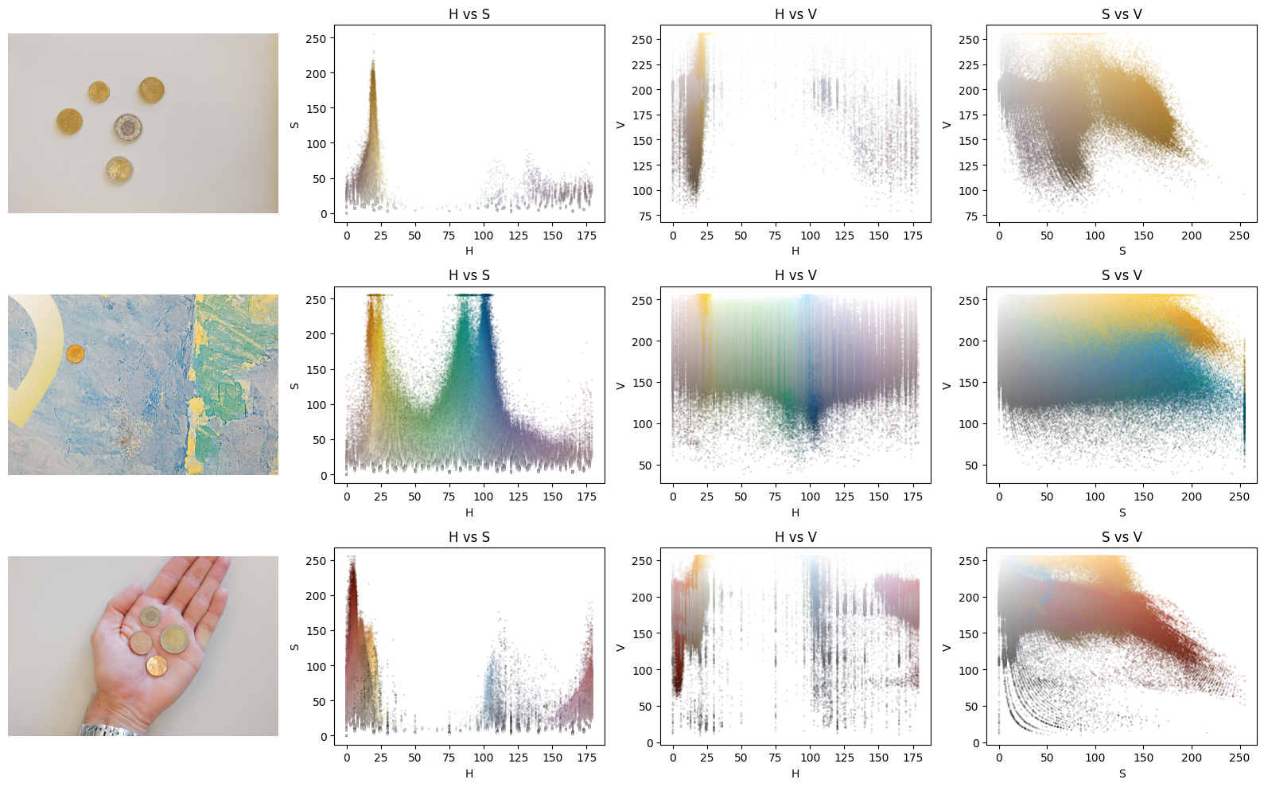
Segmentation

Slide 3
Segmentation

Slide 4
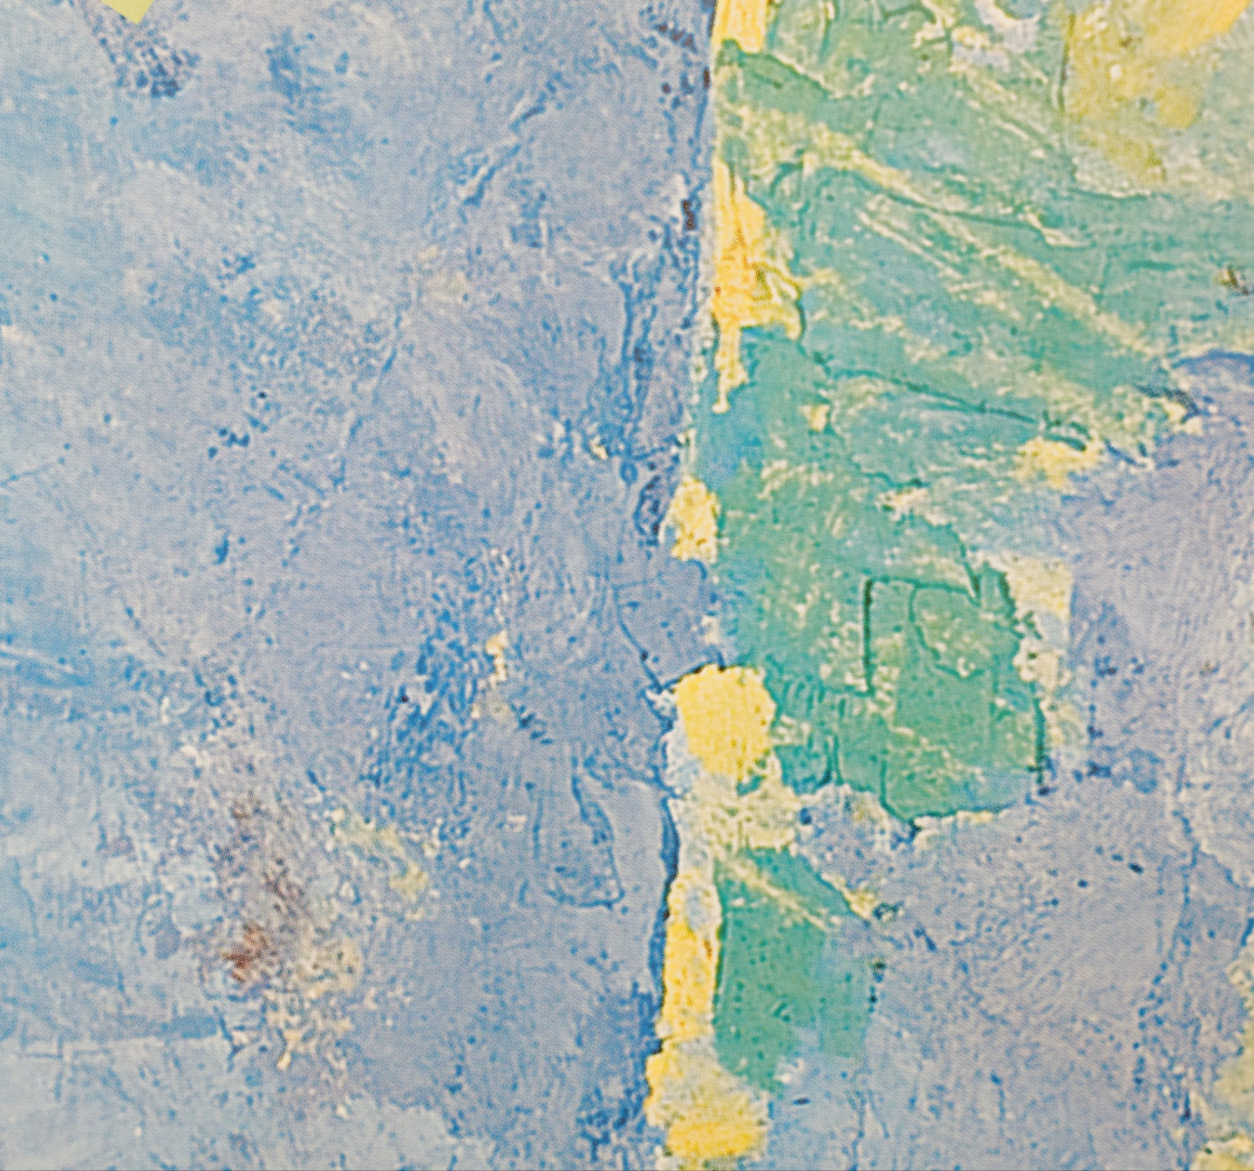
Data Augmentation
New class for over segmentation: store all the different errors of segmentation that occur. If an image is predicted to belong to this class, it will be removed.
Data Augmentation :
Random rotation
Random brightness and contrast adjustment
Random shift in color channels
Random Gaussian noise

Slide 5
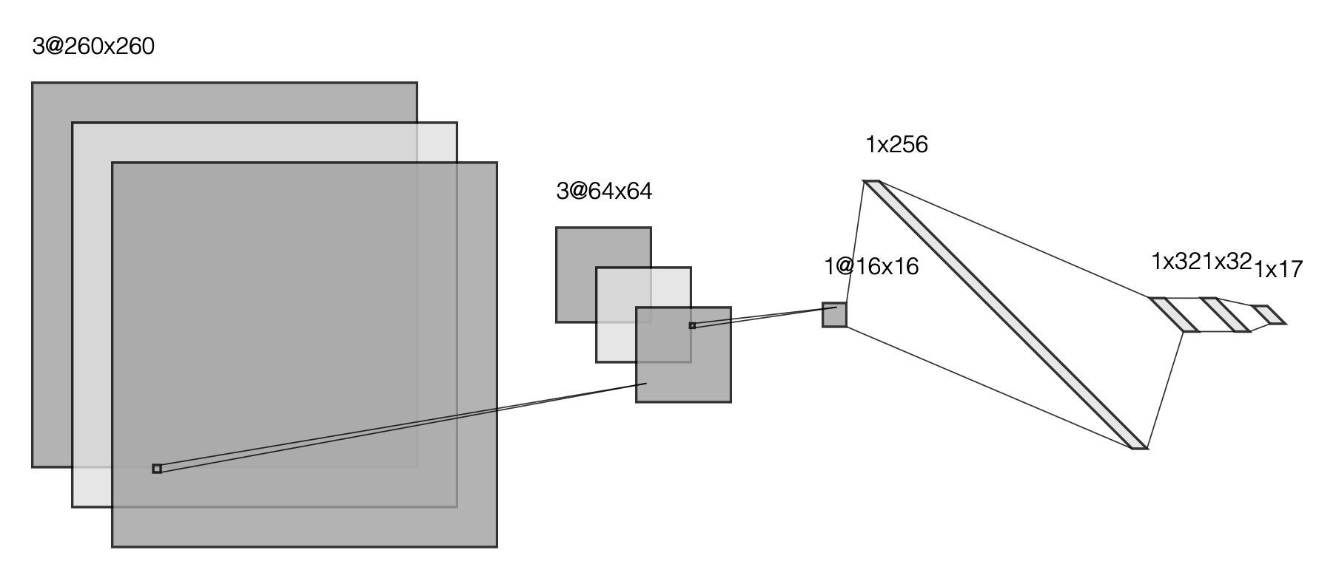
Feature extraction and classification
CNN
Data : Augment the data by apply some transformations to the images such as random rotations, random blurring, random shifts in the HSV values and random brightness and contrast adjustment. Then, balance the data
Model: The convolutional layers automatically learn spatial hierarchies of features from the images, such as edges, shapes, and textures.
Loss: Cross entropy loss (classification task)
Optimizer: AdamW

Slide 6
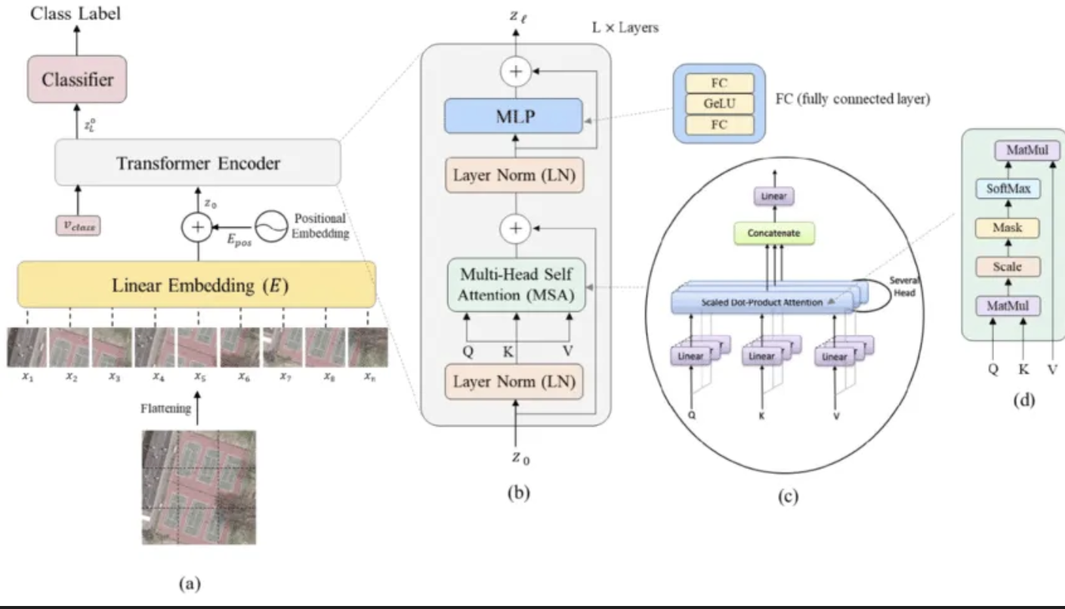
Feature extraction and classification
Vision Transformers VIT
Data : Augment the data by apply some transformations to the images such as random rotations, random blurring, random shifts in the HSV values and random brightness and contrast adjustment. Then, balance the data
Model: A Vision Transformer uses self-attention mechanisms to automatically extract features from different parts of the image and combine them to make a classification decision.
Loss: Cross entropy loss (classification task)
Optimizer: AdamW

Slide 7
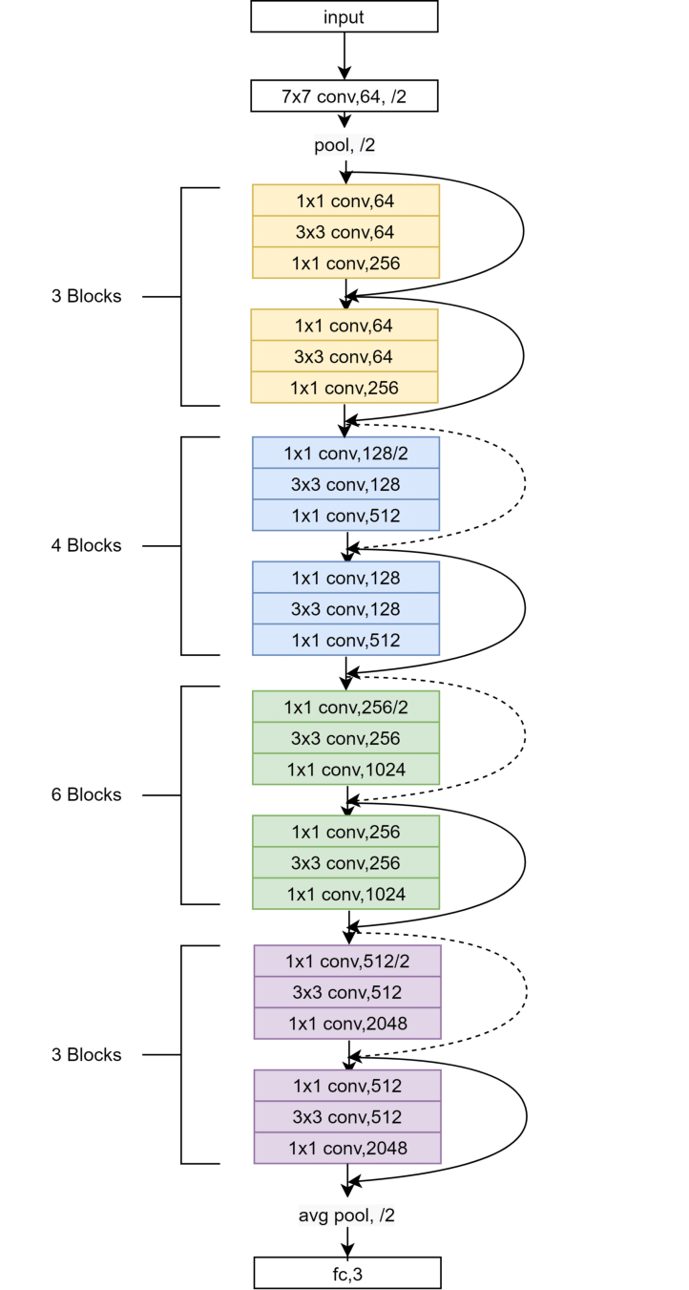
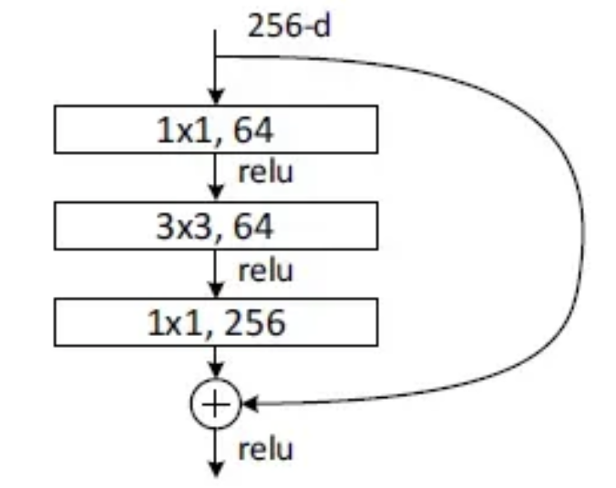
Feature extraction and classification
ResNet50
Data : Augment the data by apply some transformations to the images such as random rotations, random blurring, random shifts in HSV values and random brightness and contrast adjustment. Then, balance the data.
Model: ResNet50 is a convolutional 50 layers deep neural network, pretrained on ImageNet1K.
It consists of several blocks of 3 layers. Each increases the depth, reduces spatial dimension.
"skip connections" to mitigate the vanishing gradient problem allowing gradients to pass through an shorter path during backpropagation.
ReLU after each convolutional layer: allows only positive values to pass through, introducing non-linearity into the network, essential to learn complex patterns in the data.
Ending Layers:
- Average Pooling (/2): reduce output dimensionality.
- Fully Connected Layer (fc, 3): output classification results, a probability distribution over the classes.
Optimizer: AdamW
For each block’s convolution layers:
1st: reduces the number of channels in input data (dimensionality reduction from 256 to 64 channels/ filters) - 2nd: extract spatial features from the data (3x3 convolution to extract spatial hierarchies from small neighborhoods in the input) - 3rd: restore the original number of channels before adding the output to the skip connection(from 64 to 256 channels).

Slide 8
Results
 | CNN | VIT | RESNET 50
Train loss | 0.0179 | 2.27 | 0.03
Eval loss | 0.3864 | 2.29 | 0.07
Accuracy | 91,5 | 64.32 | 99.7
Kaggle score | 76.56 | - | 94,42

Slide 9
Thank you

