Slide 1

Swiss Federal Institute of Technology in Lausanne
School of Computer and Communication Sciences
Master Thesis in Data Science
Structured Representations for Fine-Grained Text-to-Image Retrieval in Remote Sensing
Defended on the 26/08/2025 by
Oussama Gabouj
Supervised by:
Devis Tuia, Ciprian Tomoiaga

Slide 2
1
2
3
4
5
Problem statement
Remote Sensing for Insurance Companies
Risk Assessment
Claims Processing
Asset Management
Monitor client exposure and compliance with policies
Quickly assess damage after natural disasters
Verify new assets or features for existing clients
Task: Text-to-image retrieval
keyword-based searches aren't enough.
=> We need a system that can understand:
Semantic and spatial relationships between objects
Object reasoning

Slide 3
1
2
3
4
5
Problem statement
classification
Goal: Fine-Grained Text-to-image Retrieval in RS
Retrieval
Problem 1: Fine-Grained dataset in RS
alignment
Retrieval vs. scene classification
Generic captions hinder fine-grained retrieval
Remote sensing data mostly has generic captions
=> Generate fine grained captions
Contrastive
Caption Gen
Generative
Image Gen
segmentation mask
Instruction
Report Gen
Problem 2: Fine-Grained retrieval in RS
VQA
object
detection
Single-vector embeddings lose fine-grained details
Need structured representations
=> Extract structured features
SGG
Relation
detection

Slide 4
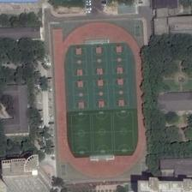
1
2
3
4
5
Remote Sensing Datasets Analysis
This is a huge playground with basketball courts and tennis courts planned orderly inside
Pairwise Image similarity matrix
Pairwise caption similarity matrix

Slide 5
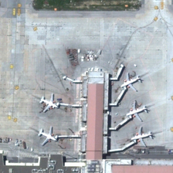
1
2
3
4
5
Fine-Grained Datasets Generation
System Prompt
You are an advanced AI model capable of understanding and describing remote sensing images. Your task is to generate a detailed textual description of the image content. Please ensure your description is clear, concise, and captures the key elements of the scene. Start your response immediately by the description.
Original Caption: many of the planes were docked on the wide.
Fine Grained Caption: The central structure is a long, rectangular building with a brownish roof. On both sides of this terminal, several passenger jet airplanes are visible, parked at gates. The aircraft are predominantly white with some markings, and they are connected to the terminal building via jet bridges or jetways, which allow passengers to board and disembark directly. The surrounding area is an expansive concrete or asphalt tarmac with various painted lines and markings, including yellow lines that likely designate taxiways or parking spots. There are also smaller vehicles and ground support equipment visible near the aircraft.
Original Caption: many of the planes were docked on the wide.
Fine Grained Caption: The central structure is a long, rectangular building with a brownish roof. On both sides of this terminal, several passenger jet airplanes are visible, parked at gates. The aircraft are predominantly white with some markings, and they are connected to the terminal building via jet bridges or jetways, which allow passengers to board and disembark directly. The surrounding area is an expansive concrete or asphalt tarmac with various painted lines and markings, including yellow lines that likely designate taxiways or parking spots. There are also smaller vehicles and ground support equipment visible near the aircraft.
--- Objects | --- Attributes | --- Relations

Slide 6
1
2
3
4
5
Fine-Grained vs Original Dataset
Pairwise caption similarity distribution
Model Retrieval
performance
.
.
.

Slide 7
1
2
3
4
5
Human evaluation
Original caption: There are some buildings beside the tennis courts.
Fine-Grained caption: The remote sensing image shows a sports complex and residential area. The sports complex includes a large green field, likely used for soccer or other field sports, and several tennis courts with blue surfaces and white lines. Adjacent to the field is a building with a brown roof. The residential area features houses with varying roof colors, including gray and brown, surrounded by green lawns and trees. A curved road is visible near the houses, suggesting a suburban neighborhood setting. The image highlights the integration of recreational facilities within a residential environment.
--- Objects | --- Attributes | --- Relations
Original caption: There are some buildings beside the tennis courts.
Fine-Grained caption: The remote sensing image shows a sports complex and residential area. The sports complex includes a large green field, likely used for soccer or other field sports, and several tennis courts with blue surfaces and white lines. Adjacent to the field is a building with a brown roof. The residential area features houses with varying roof colors, including gray and brown, surrounded by green lawns and trees. A curved road is visible near the houses, suggesting a suburban neighborhood setting. The image highlights the integration of recreational facilities within a residential environment.

Slide 8
1
2
3
4
5
Human Evaluation results
Correctness: Mean and median percentage of times participants correctly matched images to captions.
Choice Agreement: Mean and median number of unique images selected per caption, indicating agreement among participants.
Problem 1: Fine-Grained Captions for Remote Sensing Dataset ✅
Now Moving to Problem 2: Fine-Grained retrieval in RS

Slide 9
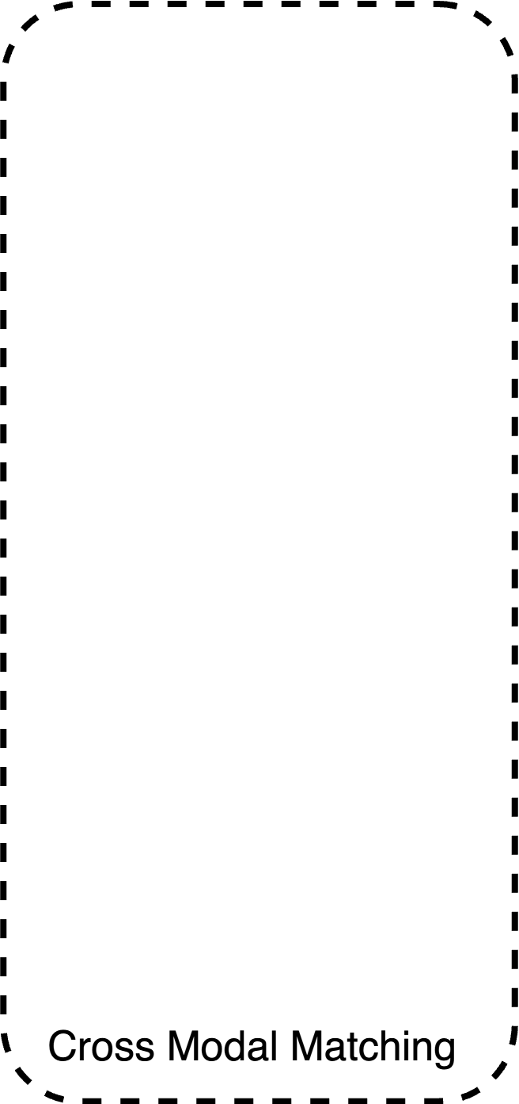
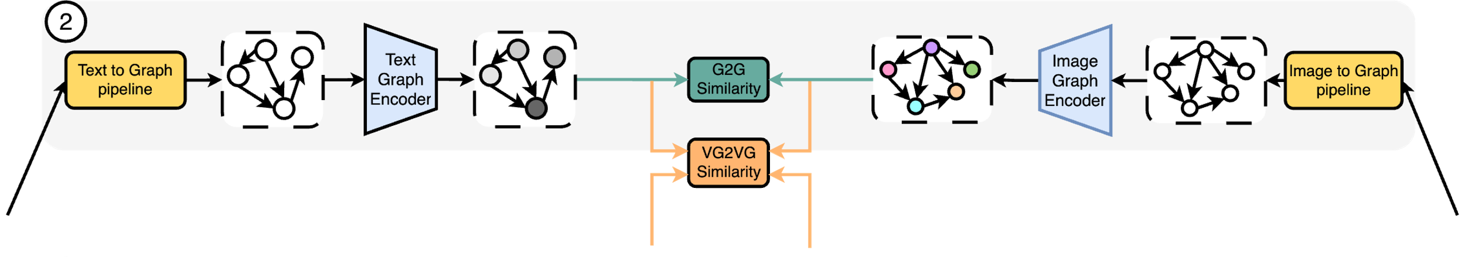
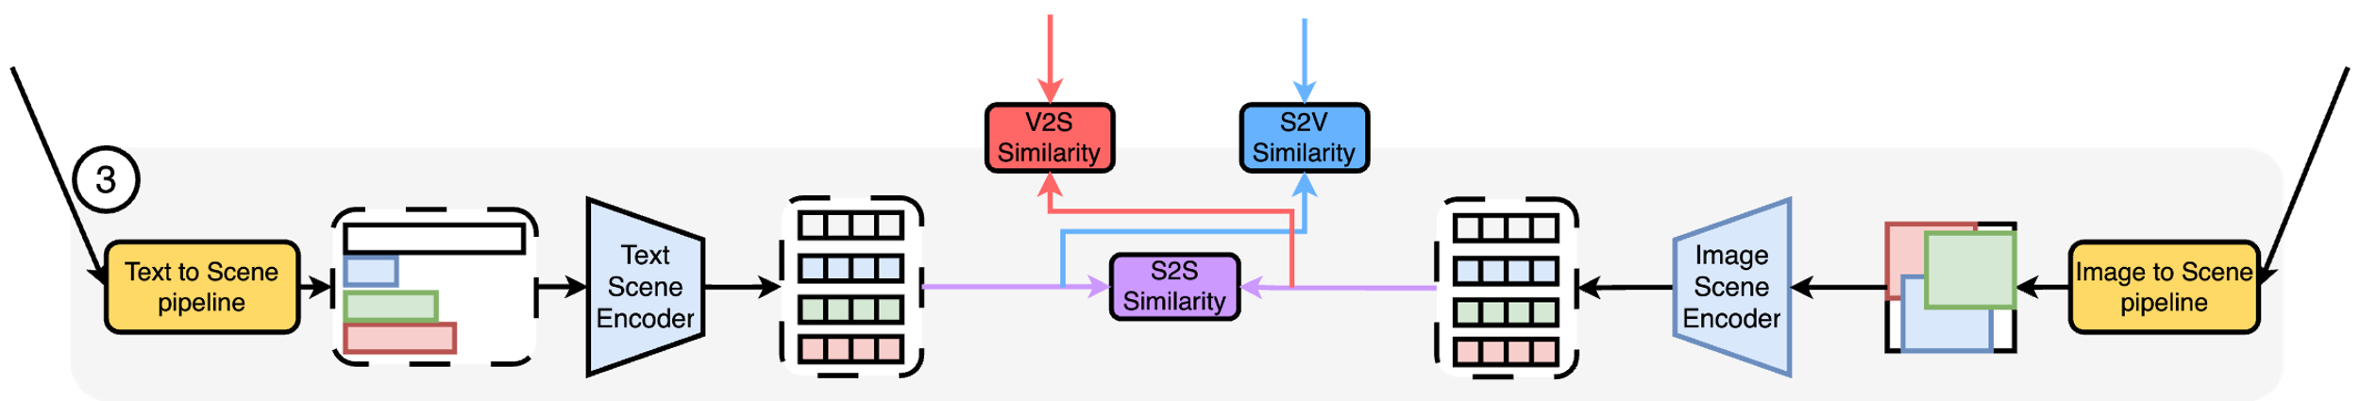
1
2
3
4
5
Framework Overview
1:Transformation
2: Embedding
2: Embedding
1: Transformation

Slide 10
1
2
3
4
5
Graph Retrieval: 1-Representation
Image-to-Graph
Text-to-Graph
Prompt Gemini to create graphs
Use detailed prompt with few shot examples

Slide 11
1
2
3
4
5
Graph Retrieval: 2-Embedding Models
Graph only
Matching
Hybrid approach:
Vector-Graph
Matching

Slide 12
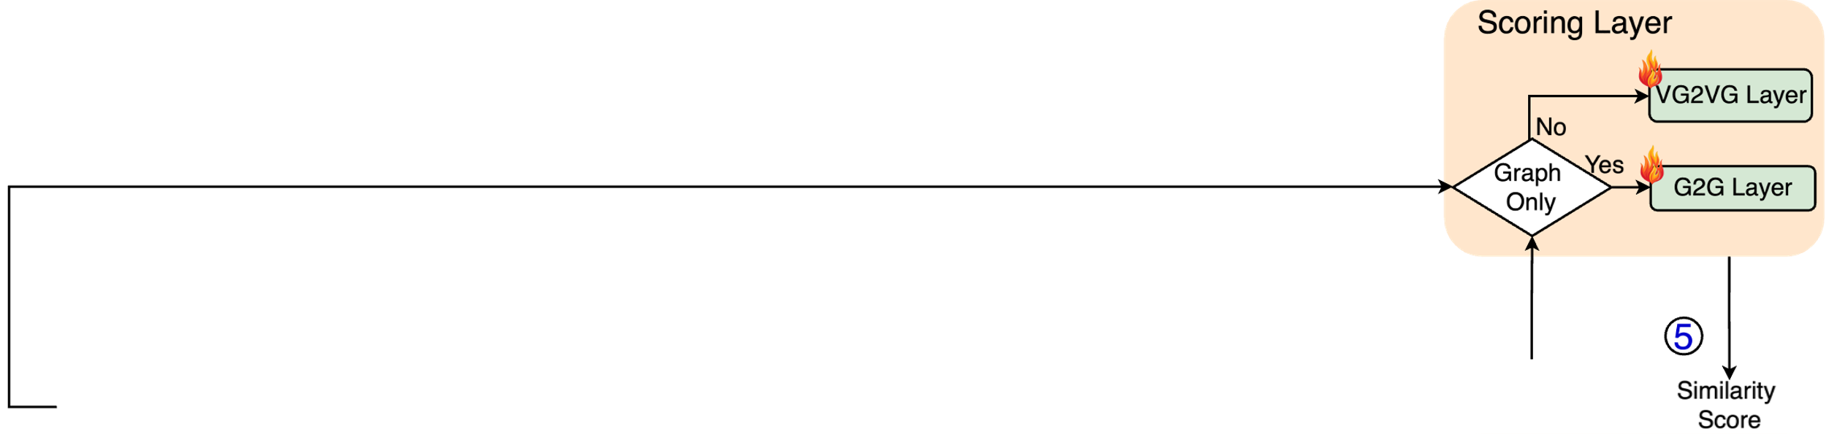
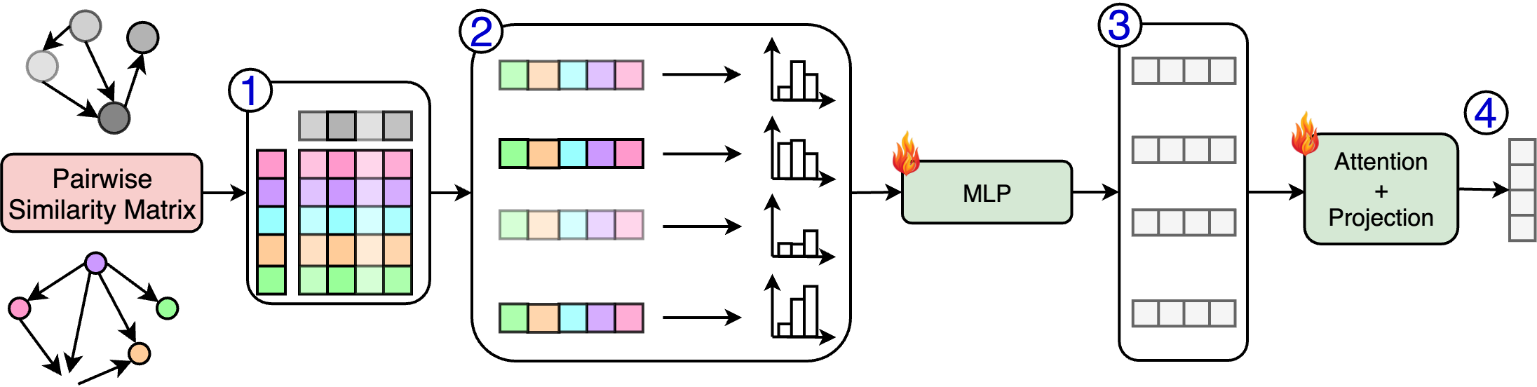
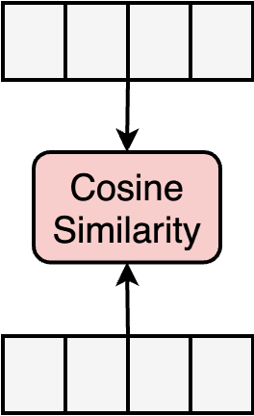
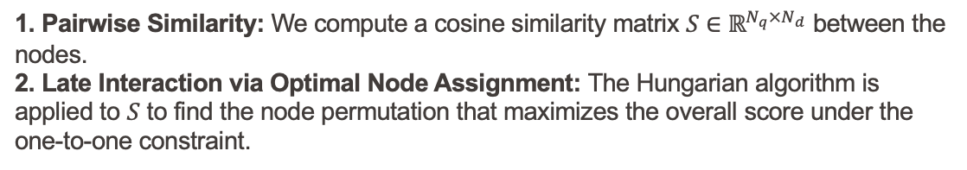
1
2
3
4
5
Graph Retrieval: 3-Matching Module
A. Hungarian Algorithm
1. Pairwise Similarity: We compute a cosine similarity matrix $S∈ℝ^{N_{q}×N_{d}}$ between the nodes.
2. Late Interaction via Optimal Node Assignment: The Hungarian algorithm is applied to $S$ to find the node permutation that maximizes the overall score under the one-to-one constraint.
B. Graph Matching Network GMN

Slide 13
1
2
3
4
5
Vector Graph Matching Results
mR = mean (R@1, R@5, R@10)
=> Training is necessary
=> GMN is better than hungarian
Hybrid matching is good but:
Requires Graph construction
Requires Training
Cost effective alternative ?

Slide 14
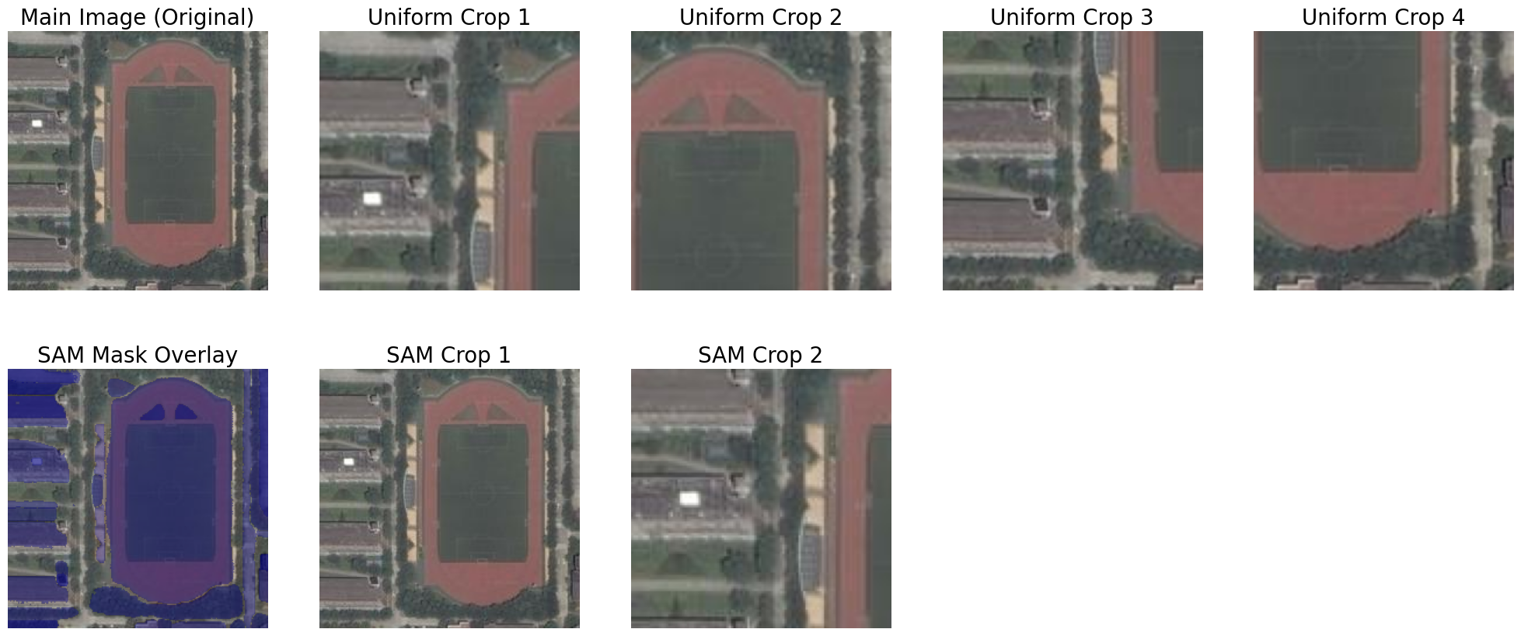
1
2
3
4
5
Scene Retrieval: 1-Representation
Image-to-Scene
Text-to-Scene

Slide 15
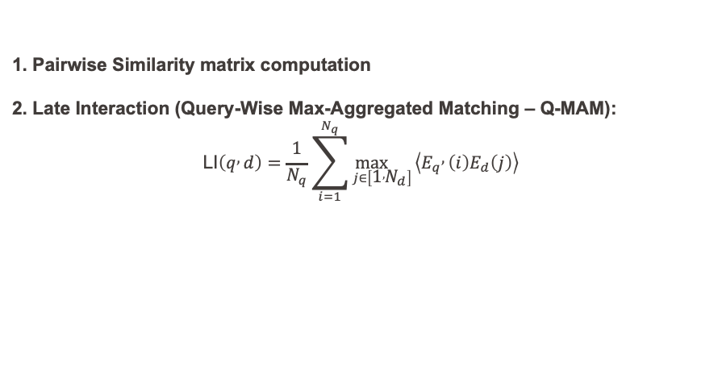
1
2
3
4
5
Scene Retrieval: 2-Scene Embedding Models
Embedding
model
Scene Retrieval: 3-Matching algorithms
1. Pairwise Similarity matrix computation
2. Late Interaction (Query-Wise Max-Aggregated Matching – Q-MAM):
$$\text{LI}\left(q , d\right)=\frac{1}{N_{q}}\sum_{i=1}^{N_{q}}{\underset{j∈\left[1 , N_{d}\right]}{\max{}}}\left\langle E_{q} , \left(i\right)E_{d}\left(j\right)\right\rangle$$
Matching
Algorithm

Slide 16
1
2
3
4
5
Scene Matching Results
=> V2V Performs Poorly
=> Text as a scene is important
=> S2S is the best approach

Slide 17
1
2
3
4
5
Models Comparison 1: Matching Results
Original dataset:
S2S is the best approach
Fine Grained dataset:
VG2VG is the best approach

Slide 18
1
2
3
4
5
Models Comparison 2: Performance and use case
Settings:
Dataset: 1,069 images and 5,345 queries; focus on runtime since data preparation is done offline.
Batch size: 1,024 (limited by GPU memory, NVIDIA RTX A6000, 48 GB).
x 4
x 2

Slide 19
1
2
3
4
5
Conclusion & Future Work
Main contributions:
Dataset Benchmarking & Fine-Grained Captions
Multimodal Structured Representations
3 retrieval models:
Graph matching
Hybrid matching by adding the graph component as a plugin layer
Scene-Based Matching as Lightweight Alternative
Future Work
Robust SGG Pipelines
Learnable Scene Segmentation

Slide 20
THANK YOU FOR YOUR
ATTENTION

Slide 22
Vector graph performance on orignal dataset

Slide 23
Graph collision rate

Slide 24
Contents
Introduction
Dataset Analysis and Fine-Grained Data Generation
Proposed Cross-modal Retrieval Framework
Model Comparison and Use Case
Conclusion

